Slide 1
ZenGRC is the leader in IT risk management solutions, empowering organizations to convert risk into a strategic business advantage. ZenGRC helps organizations more efficiently organize and intelligently optimize infosec programs to better protect their business and build customer trust.
Notes:
Before we start, let me quickly introduce you to RiskOptics.
We help you see risk differently by tying risk to your business strategy. This helps you make strategic, risk-informed business decisions.
Today, I’m going to share with you a few ways that this approach can help you see risk more clearly, stay ahead of threats, convey the impact of risk in financial terms your leadership understands, and give time back to your teams.

Slide 2
Providing GRC solutions to meet the needs of the growing interconnectedness across an evolving digital business
Single Source of Truth
One easy-to-use, fully integrated and automated platform
Better Visibility
Provides continuous visibility through pre-built integrations to popular 3rd party apps
Shorter Audit Cycles
Reduces time and cost of audits, increases team efficiency and streamlines workflow
Notes:
This approach delivers many benefits to your organization. First and foremost, it helps you be more strategic in your approach to IT Risk Management
InfoSec leaders are able to craft programs around key business priorities
And this allows them to communicate risk in a language leadership understands and gain multiple levels of visibility
It will also make it easier for teams to get their job done because they are focused on more strategic work. They can spend less time fighting fires and more time planning growth.
Stay ahead of threats - you’re able to do more On-Demand assessments and continuous monitoring which can set the foundation and move closer to real-time risk performance management.

Slide 3
Delivering GRC and more
VENDOR RISK MANAGEMENT
Create a more efficient and less manual risk-based approach to vendor management
ADDITIONAL USE CASES
Pre-built assets and expert support for use cases like Business Continuity, Policy Management, etc
RISK MANAGEMENT
Manage Risk across threats, incidents, and vulnerabilities from a single point
SYSTEM OF RECORD
INTEGRATIONS
ZenGRC delivers pre-built and tested integrations to empower greater efficiencies
SINGLE SOURCE
OF TRUTH
COMPLIANCE
Unified control management across frameworks for real-time control status
BENCHMARKS
Compare performance to other companies in your industry

Slide 4
Frameworks for Every Industry
Government
GRC requirements include the need to protect personal data, payment information, medical records, intelligence data, threat assessments, scientific research, and much more.
Frameworks for Compliance:
FedRAMP
HIPAA
GDPR
CMMC
NIST

Slide 5
Frameworks for Every Industry
Technology
GRC requirements can include protecting intellectual property and customer information, eliminating vulnerabilities in point-of-sale systems, and minimizing third-party risk among many other regulatory obligations.
Frameworks for Compliance:
SOC
NIST
ISO
HIPAA
GDPR
CMMC

Slide 6
Frameworks for Every Industry
Healthcare
Manufacturing
Education
GRC requirements: cybersecurity, data privacy, and educational infrastructure
Frameworks for Compliance:
GDPR
HIPAA
NIST
GRC requirements: protection of critical infrastructure, personal data privacy, and minimizing cybersecurity threats
Frameworks for Compliance:
HIPAA
NIST
PCI
GRC requirements: cybersecurity, data privacy, and vendor security
Frameworks for Compliance:
HIPAA
GDPR
NIST

Slide 7
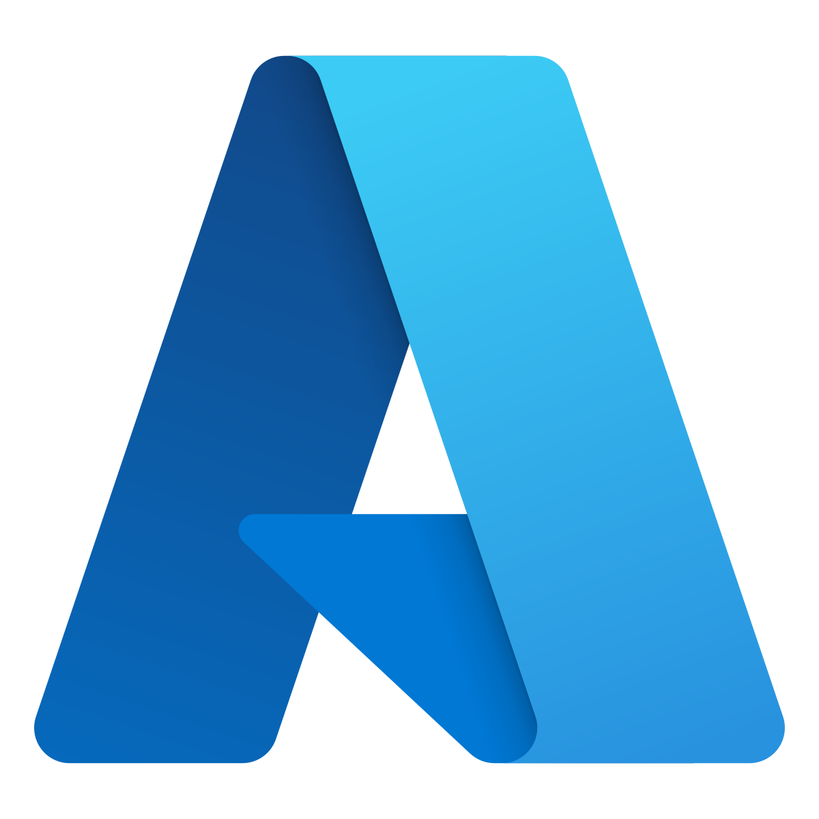
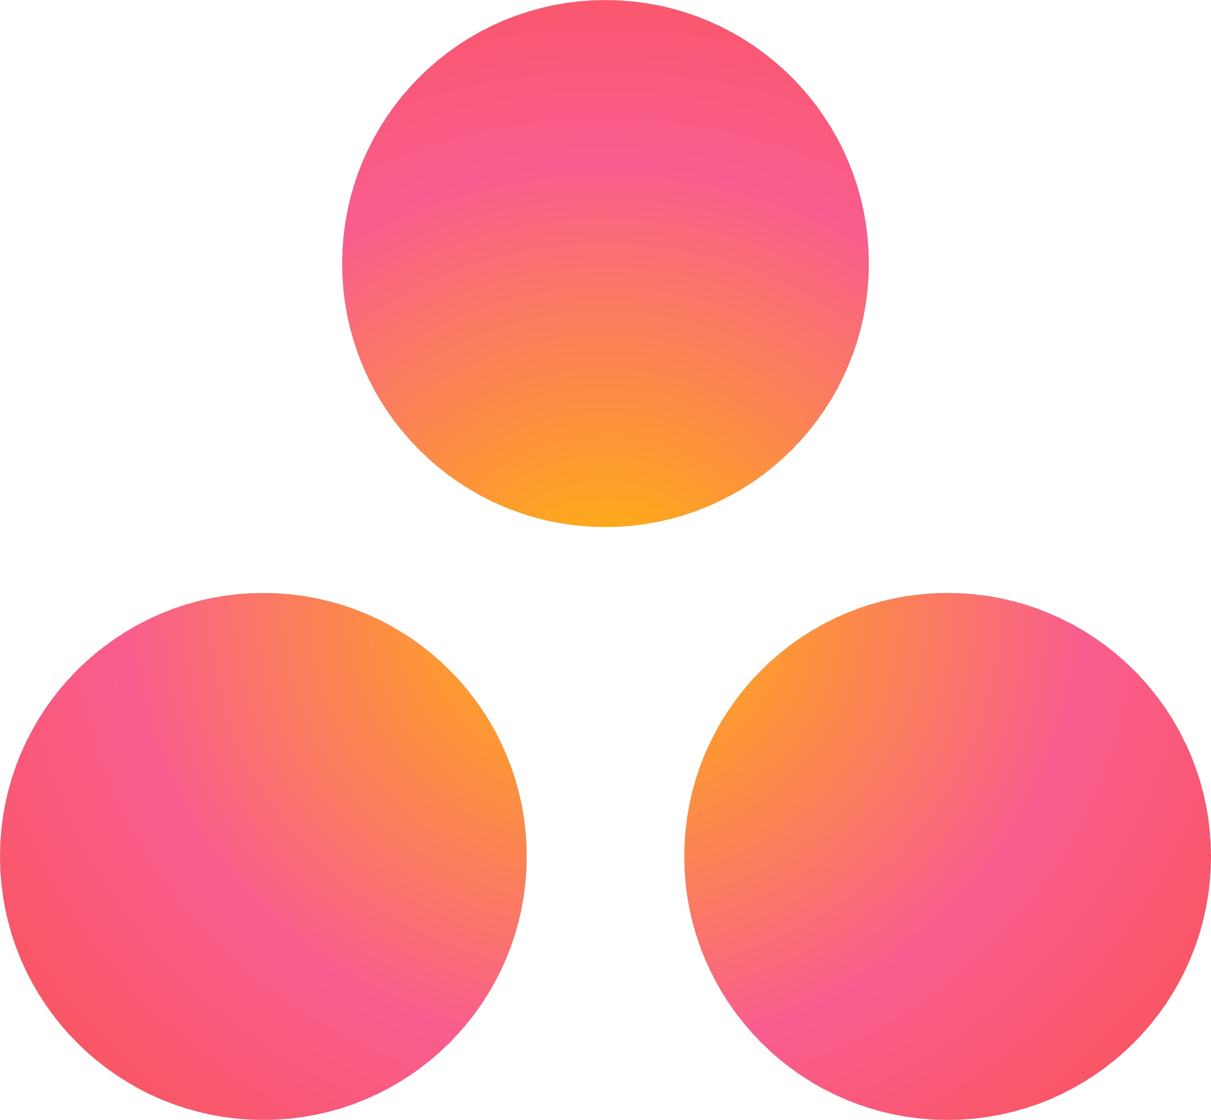
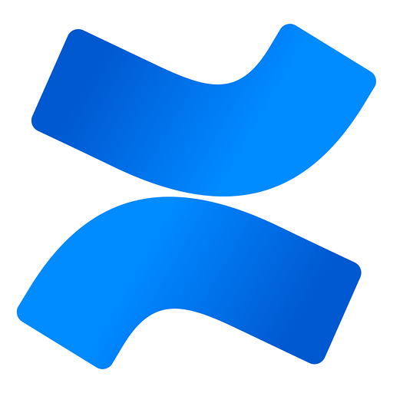
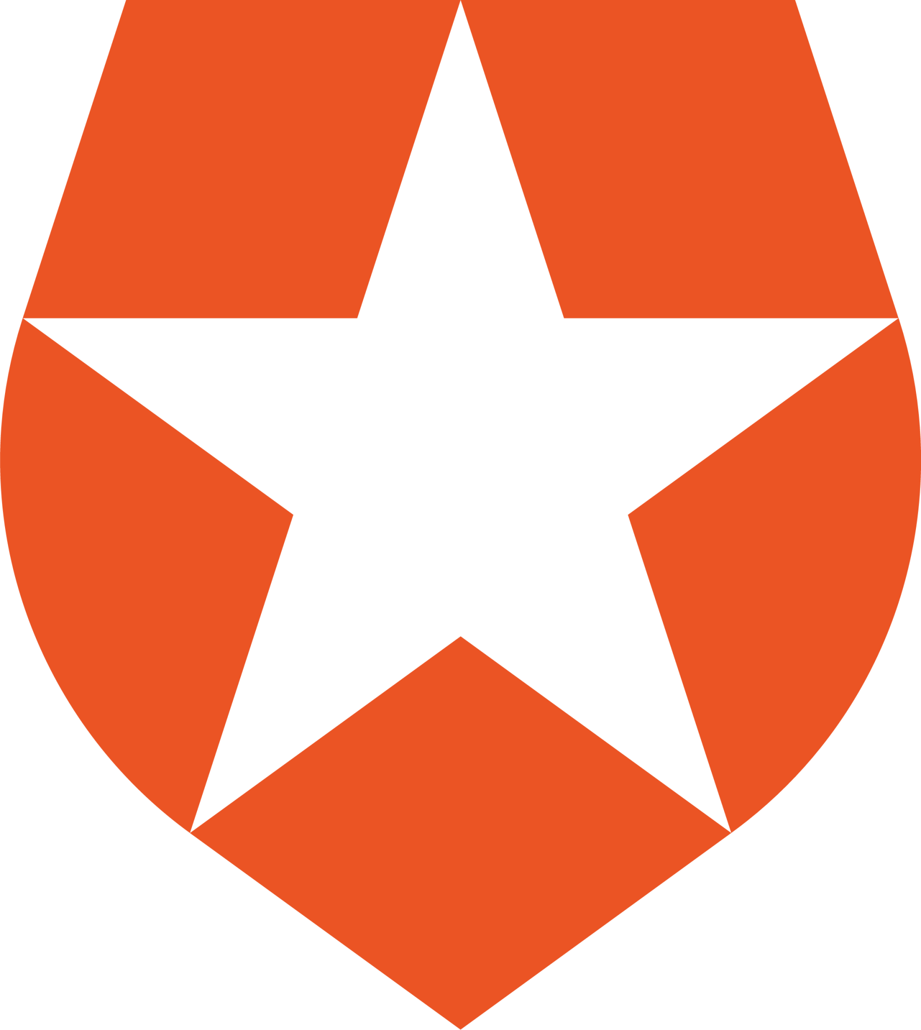
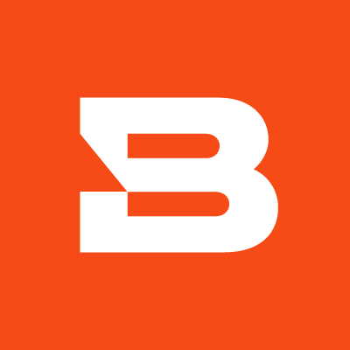
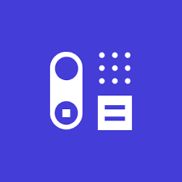
Integrations in ZenGRC
1password
Aha!
Asana
Atlassian Confluence Cloud
Auth0
AWS CloudTrail
AWS CloudWatch
AWS Code Commit
AWS Config
AWS GuardDuty
AWS IAM
AWS Inspector​
AWS Security Hub​
Azure​
BambooHR​
Bitsight​
Capsule CRM​
CircleCI​
Datadog​
GitHub​
Gitlab​
Google Workspace
KnowBe4​
Kubernetes​
LaunchDarkly​
Microsoft 365​
Okta​
RiskRecon​
SecurityScorecard​
ServiceNow​
Square​
Tenable​
Zendesk​
Notes:
JEN
- Share the exciting news that we're evolving our educational content by transitioning from the University and RU platforms to a vibrant community learning experience.
- Emphasize that this shift is about enhancing your interactive, user-friendly experience with more resources and features.
- Explain how a centralized community hub simplifies your learning journey, eliminating the need for multiple logins and platforms.
- Announce the timeline for this evolution (new training site coming in October!)roar, reassuring customers that all crucial RU content will be seamlessly incorporated into the community space.
- Discuss our renewed focus on creating a dynamic blend of videos and knowledge base articles, designed to offer you a comprehensive yet flexible learning experience.
- Announce the introduction of a dedicated "Training" page within the community. This will be your one-stop-shop for all learning materials, tutorials, and resources.
- Describe the type of content that will populate this new hub - we're committed to making this a resource-rich space, including both ZenGRC and ROAR content, thereby allowing you to find everything you need in one place.
- Add that our community approach allows us to be agile in updating and expanding our training library, ensuring you always have access to the latest and most relevant information.
- Encourage open lines of communication for any questions, concerns, or insights customers may have. We're here to make this transition as smooth as possible for you.

Slide 8
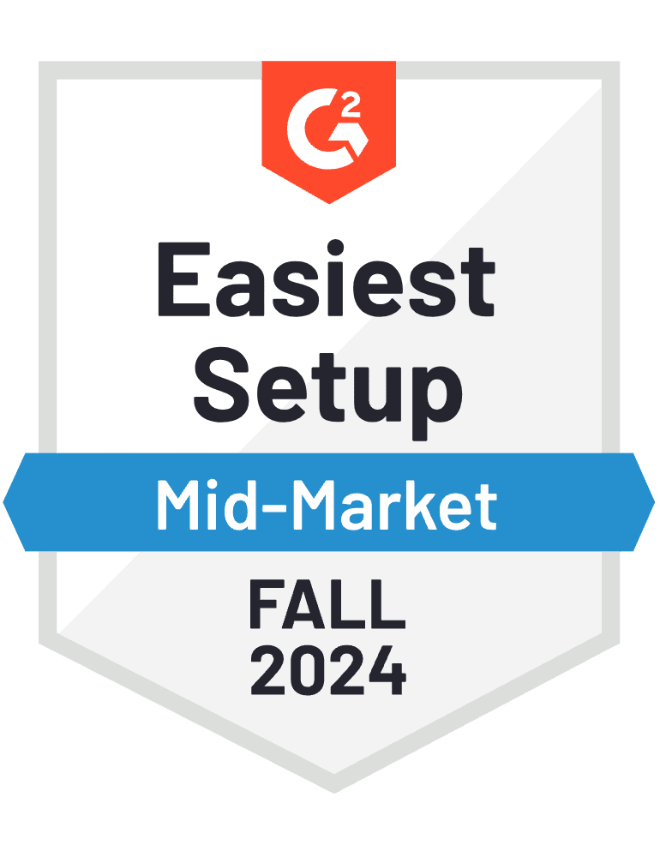
Implementation
Your clients onboarding experience at ZenGRC will include:
Average time of onboarding is 4 - 8 weeks to be fully operational, depending on customer availability.
Dedicated onboarding specialist
Implementation of unlimited frameworks
Expert GRC guidance including writing controls and building a consolidated control framework
Import of existing compliance data
Audit workflow review and training

Slide 9
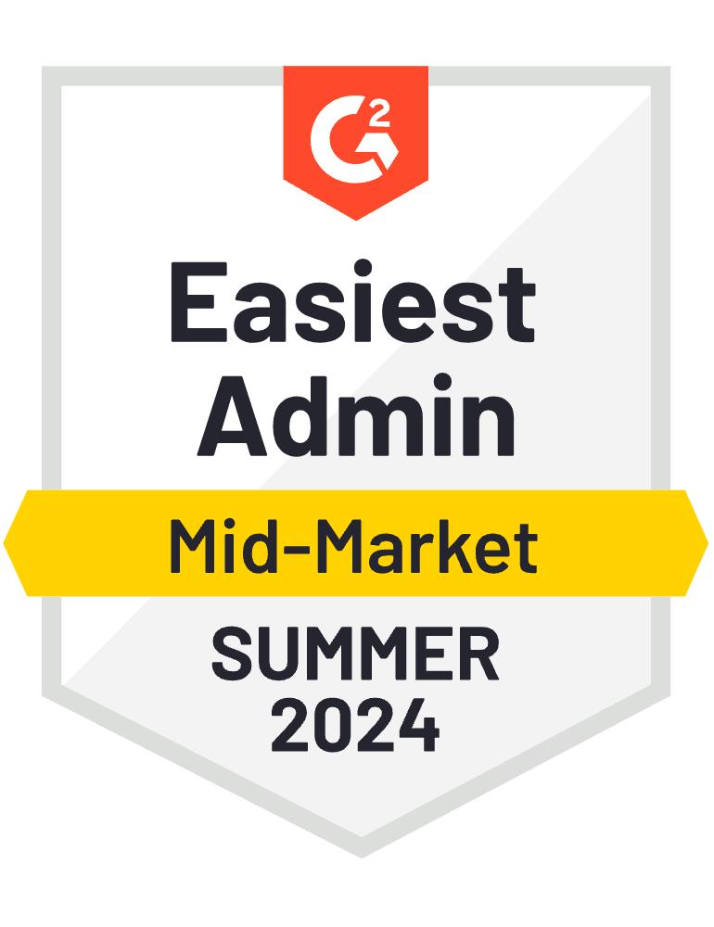
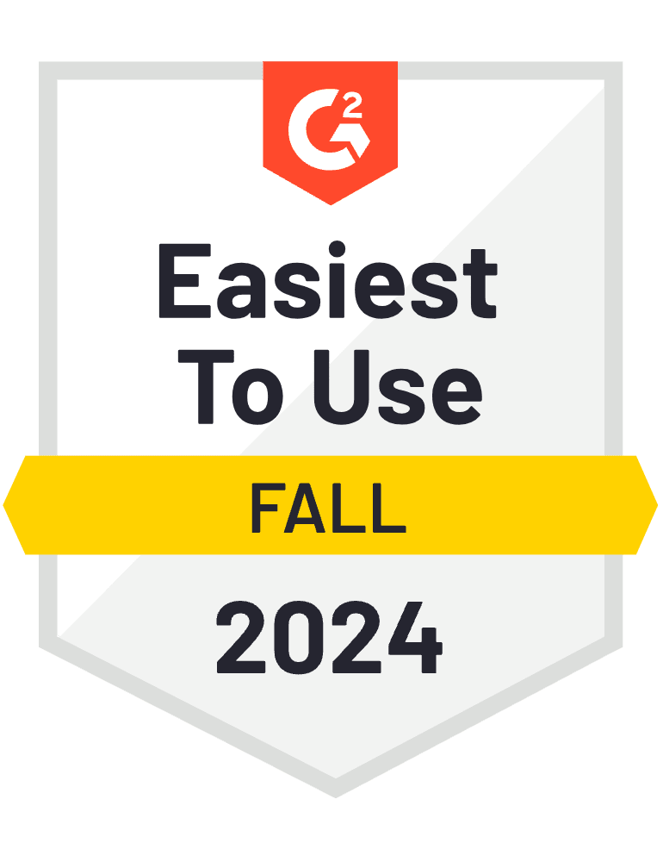
Customer Success
Your clients will be supported through a variety of touchpoints and resources, including:
Dedicated Customer Success Manager (CSM) relationship for the duration of their contract, including:
Regular meetings with their CSM
Quarterly Business Reviews with their CSM
Support from Technical Success team for any technical issues
Audit & Risk training through first Audit
Access to key leadership and product management team at ZenGRC via:
Membership to our Product Advisory Board, if they so choose
Quarterly User Groups to see the latest product updates
Access to the ZenGRC Community (training videos, Knowledge Base articles, access to the ZenGRC team for questions, and more).

Slide 10
Customer Success
Leveraged a single system of record for all compliance initiatives, reduced
the need for 3rd party auditors
Revamped security program to bring automation and efficiency gains to risk, audit and privacy management
Selected ZenGRC for the quick time to market, prebuilt content and ability to create custom attributes
Streamlined gap assessments from 8 months – to
45 min
Reduced internal audit costs by
35%
Created expedited Soc 2 controls and saved
60 days
Eliminated need for 3rd party consulting firm, saving
$80k
Up and running in less than
15 days
50 hrs
/month saved on Customer Assurance and Risk Mgmt activities

Slide 11
Thank You!
Proprietary and Confidential, ZenGRC, Inc.
Notes:
Before we start, let me quickly introduce you to RiskOptics.
We help you see risk differently by tying risk to your business strategy. This helps you make strategic, risk-informed business decisions.
Today, I’m going to share with you a few ways that this approach can help you see risk more clearly, stay ahead of threats, convey the impact of risk in financial terms your leadership understands, and give time back to your teams.

